Slide 1

HATE SPEECH DETECTION
Subject- intro to informatics(34961)
By- fahad Mehfooz
Instructor- Leon todd johnson

Slide 2

Contents
INTRODUCTION
PROBLEM STATEMENT
METHODOLOGY
DATA ACQUISITION
EXPLORATORY DATA ANALYSIS AND DATA CLEANING
TRAIN - TEST SPLIT
DATA PREPROCESSING
FEATURE ENGINEERING
DATA MODELLING
MODEL INTERPRETATION
TRAIN AND TEST INTERPRETATION
CONCLUSION
CHALLENGES FACED
FUTURE SCOPE OF WORK

Slide 3

INTRODUCTION
Importance: Ensures safe, inclusive digital environments.
Prevention: Averts escalation to violence and discrimination.
Legal Compliance: Adheres to laws and platform policies.
Educational Role: Teaches appropriate online conduct.
Insightful Analysis: Offers insights into societal biases.

Slide 4

PROBLEM STATEMENT
The proliferation of hate speech on social media platforms, particularly Twitter, poses significant challenges to maintaining a respectful and inclusive online environment. The primary challenge lies in accurately identifying and categorizing such content, considering the subtle nuances and contextual dependencies of language. Developing a model based on this dataset would significantly enhance the efficiency and accuracy of hate speech detection on social media platforms like Twitter.
We have been provided with features like:
Class label- Suggests speech is hateful or not.
Count -number of CrowdFlower users who coded each tweet.
Hate Speech - number of CF users who judged the tweet to be hate speech
Offensive language- number of CF users who judged the tweet to be offensive
Neither - number of CF users who judged the tweet to be neither offensive nor non-offensive
Tweet – Tweets from users.

Slide 5
METHODOLOGY
Data Preprocess
Data Acquisition
Data Wrangling and Cleaning
Feature Engineering
Train and Test Interpretation
Train - Test Split
Data Modelling
Model Interpretation

Slide 6
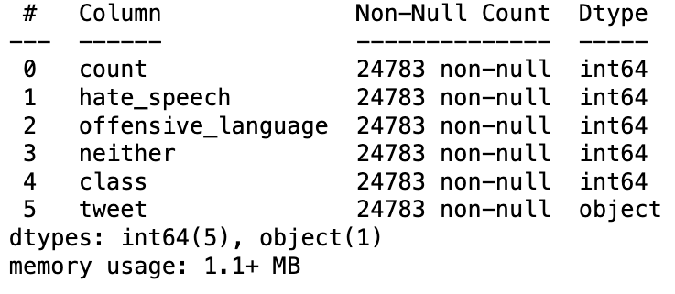
DATA ACQUISITION
The first step in the pipeline aims at importing our dataset into our environment. In our case; we will import the dataset provided by the insurance company.
The dataset consists of about 24783 rows and 6 columns including our target feature.
EXPLORATORY DATA ANALYSIS
First we will have a preliminary look on the information provided by our dataset.

Slide 7
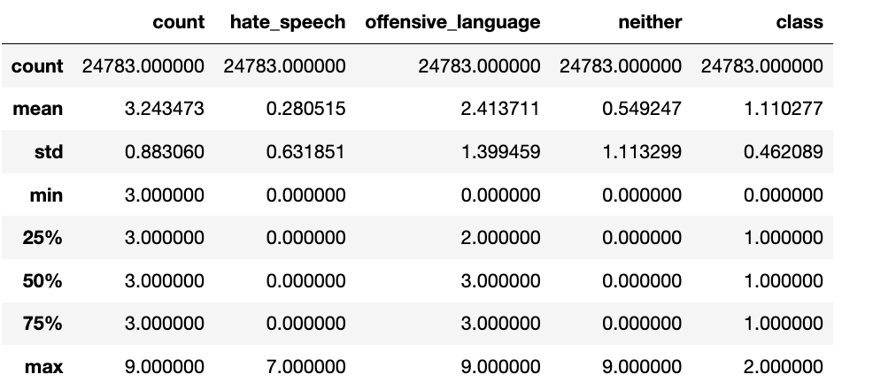
We observe that we have 24783 entries in our dataset and none of the columns contain any null values.
Further it is also checked that there are no duplicate rows in our dataset which means that we have data on 24783 unique tweets.
Each column has all its entries of the same type as described by the column itself which means that there are no miscellaneous data in any column.

Slide 8
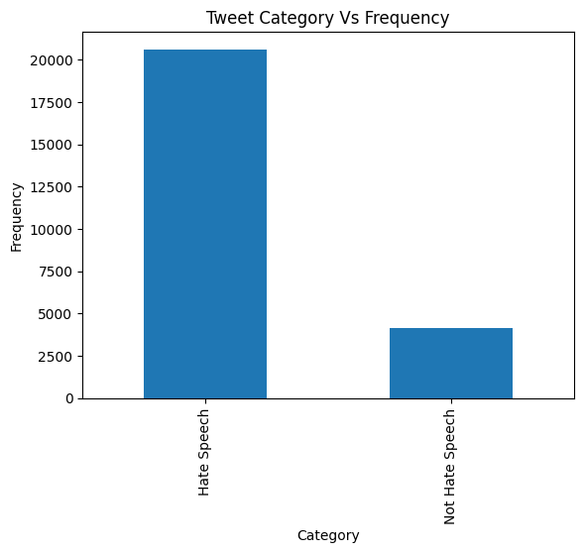
UNIVARIATE ANALYSIS
A class imbalance can be seen here between hate speech and non hate speech tweets.

Slide 9
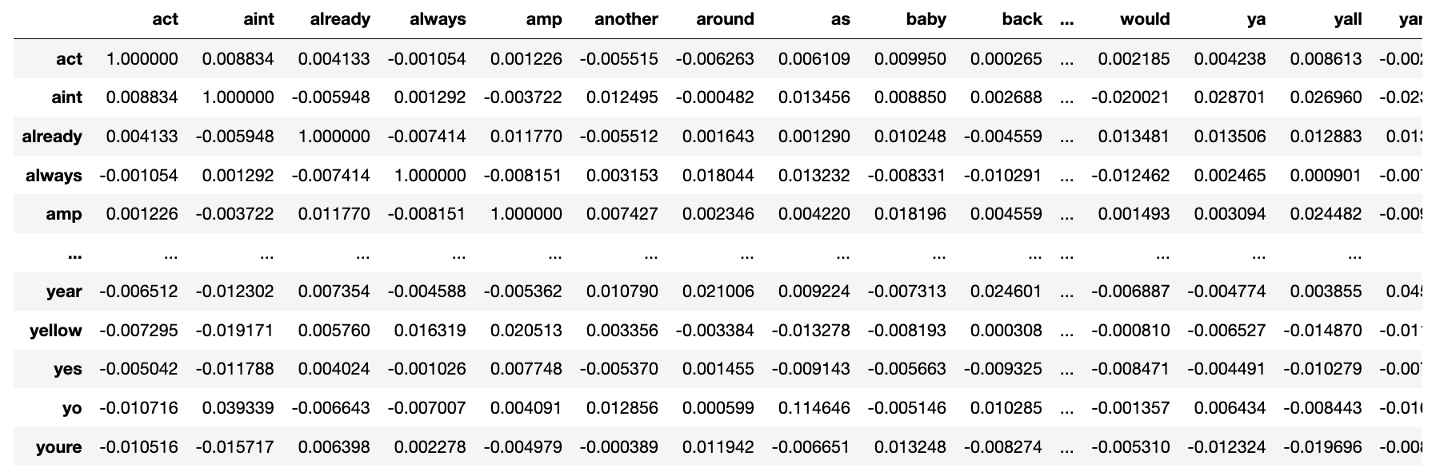
MULTIVARIATE ANALYSIS

Slide 10
DATA CLEANING
Data Cleaning for Tweets.
Numbers removed using regex.
Special characters and digits eliminated.
Words with repeated characters removed.
Text tokenization.
Removal of stopwords.
Lemmatization of tokens.

Slide 11
TRAIN-TEST SPLIT
After cleaning the data; the dataset is split into Train - Test datasets. This is done to ensure that our test dataset is completely isolated and there is no information leakage during the training process of machine learning models.
DATA PREPROCESSING AND FEATURE ENGINEERING
The following targets are to be achieved by this stage:
Encoding the tweets column with TF-IDF vectorizer to convert them into numeric columns.
Removing class imbalance from our dataset where by using class weights to ensure class with lower number of examples gets higher weight.

Slide 12
DATA MODELLING
Taking recall as the measure of performance for the classification problem; three models were tested which gave comparable and best results among the classifiers.
Logistic Regression: It is a statistical model that in its basic form uses a logistic function to model a binary dependent variable, although many more complex extensions exist for multiclass classification tasks.
Decision Tree: This is a non-parametric supervised learning method used for classification and regression that breaks down a dataset into smaller subsets while at the same time developing an associated decision tree incrementally.
Gradient Boosting Machine (GBM): It is an ensemble technique that builds sequential models, typically decision trees, where each tree corrects the errors of the previous ones in a step-wise fashion to improve predictive accuracy.

Slide 13
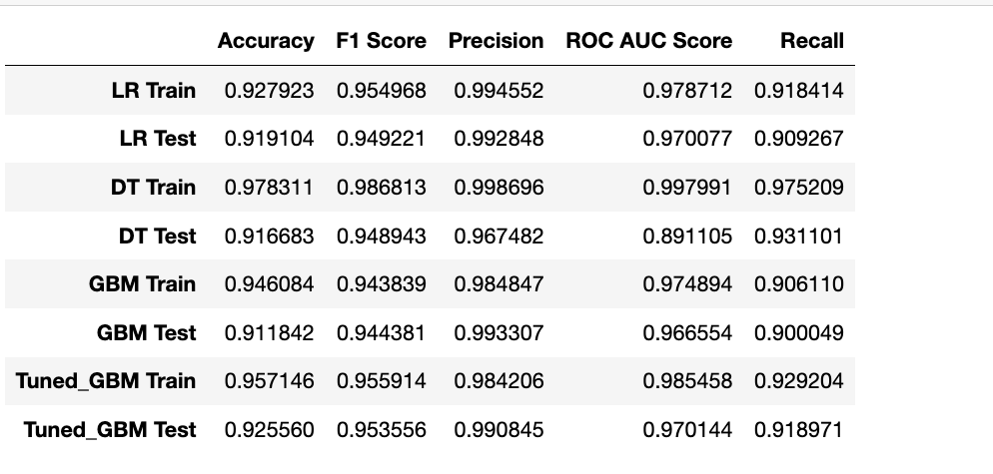
RESULTS OF DATA MODELLING

Slide 14
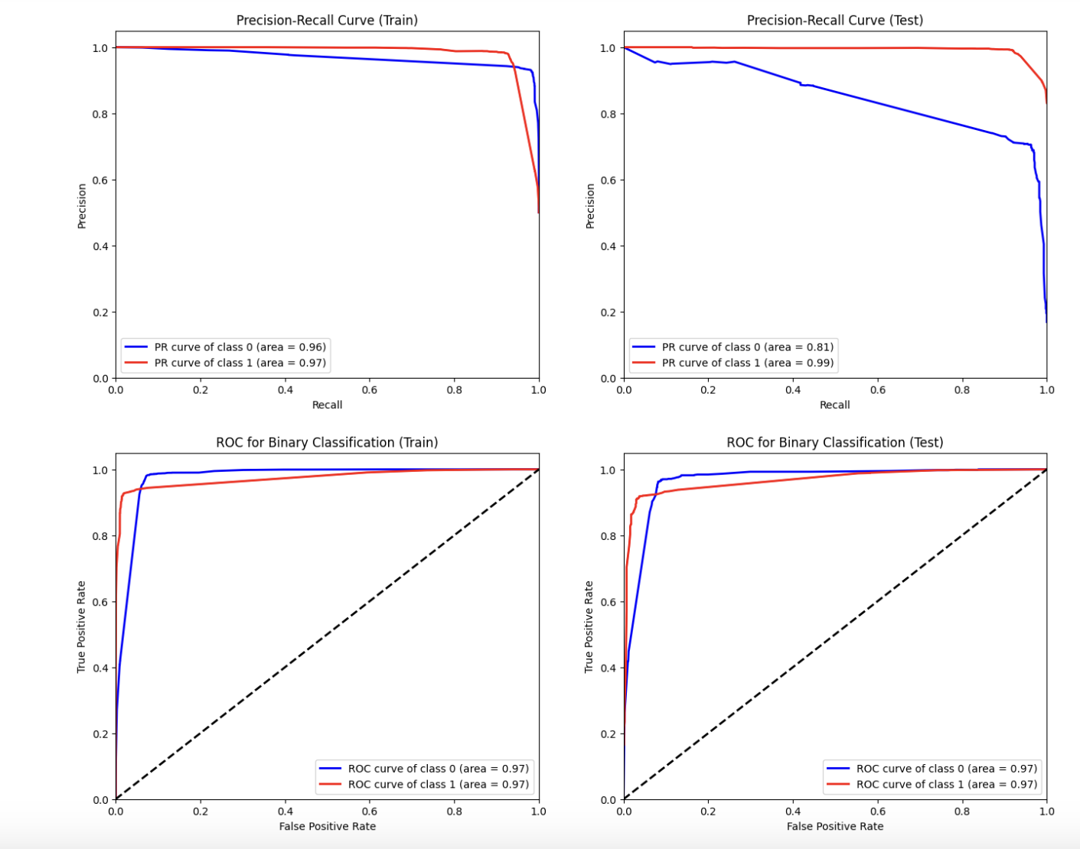

Slide 15
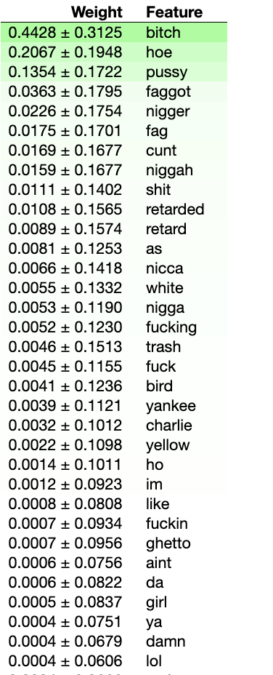
MODEL INTERPRETATION USING ELI5

Slide 16

TOOLS USED:
Python
Streamlit
Github

Slide 17

APP DEPLOYMENT
The application is deployed on streamlit.
A user can check if a particular text contains hate or not.
App link: https://hate-speech-or-not-ryh8sgyuzlfnrsvy2xjr2k.streamlit.app/
Project link- https://github.com/fahadmehfooz/Hate-Speech-Or-Not

Slide 18

CONCLUSION
Established a model for the client’s classification problem wherein given a tweet, the model is able to predict whether the tweet contains hate speech or not. The model was able to predict with a recall score of 0.91 performance.
Model Interpretation also shows how each feature contributes to the Response.

Slide 19

CHALLENGES FACED AND LIMITATIONS
The dataset contained a mix of textual and numeric features. Some form of encoding were to be created for the textual data.
The textual features were selected on the basis of how frequent are they or how less frequent are they to handle computation but to build a more comple model we would want to include more features.
Detecting hate speech requires understanding context, which can be challenging for a machine learning model. Sarcasm, satire, and colloquial language can be misinterpreted by the model.
Hate speech often involves subtle nuances, regional slang, and cultural references that models may fail to capture accurately. A model trained on data from one region or demographic may not perform well on data from another.

Slide 20

FUTURE SCOPE OF WORK
Different techniques can be tried out to deal with imabalance, class weights might not be the most effective here.
In textual based models, context often is necessary. We can go on to sequence based models like RNN to get better results.

